Slide 1

A Brief Introduction to Bioinformatics in Human Genetics
Xinghua Mindy Shi
x.shi@uncc.edu
http://shilab.uncc.edu
Department of Bioinformatics and Genomics
University of North Carolina at Charlotte

Slide 2
Outline
A Brief Introduction to Bioinformatics and Human Genetics
Joint Effect of Genetic Variants on Phenotypes
A Network Approach for Integrative Analysis of Genomic Data
Genetic Privacy
Summary and future work

Slide 3

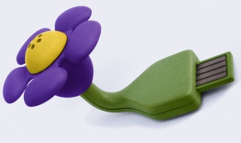
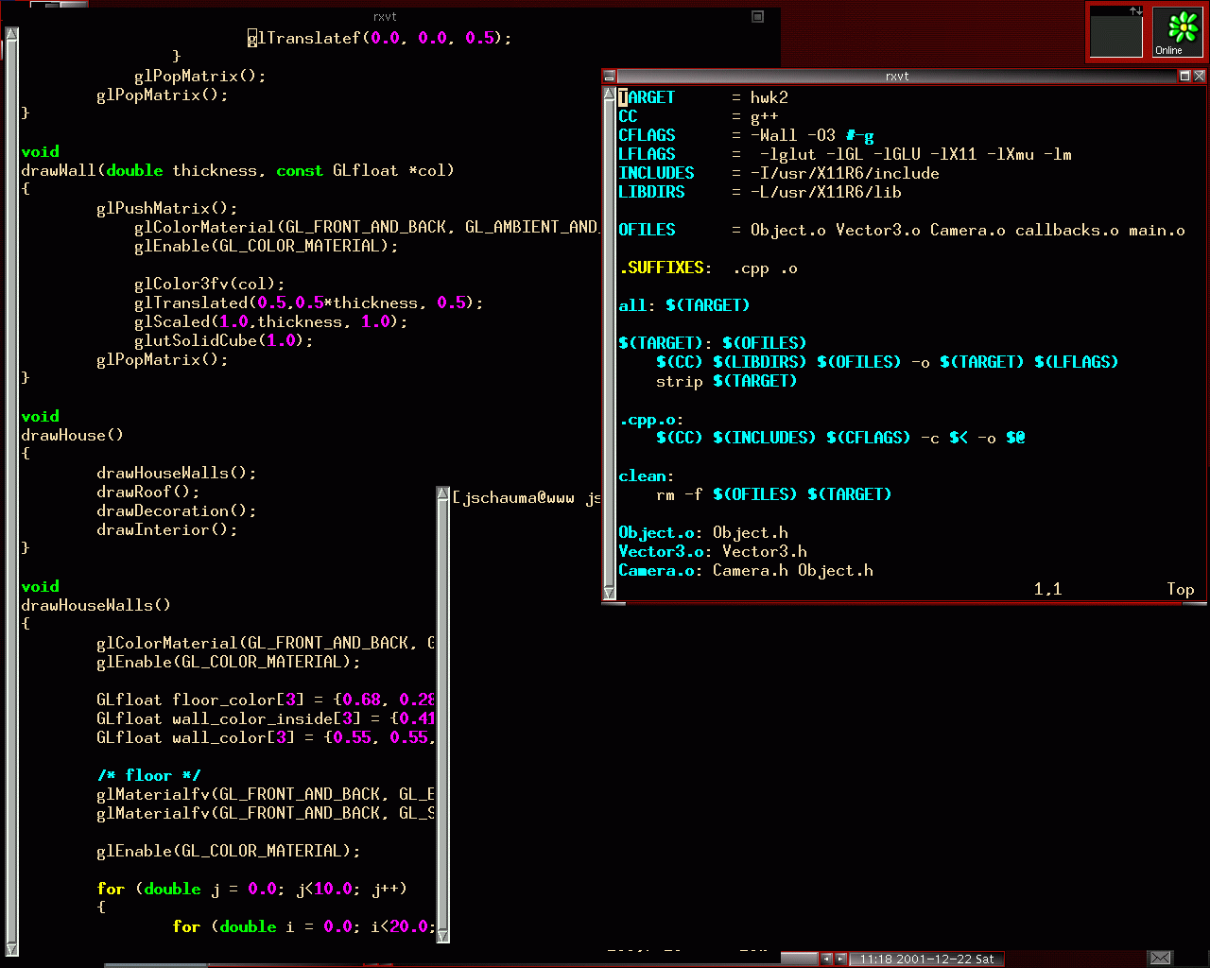
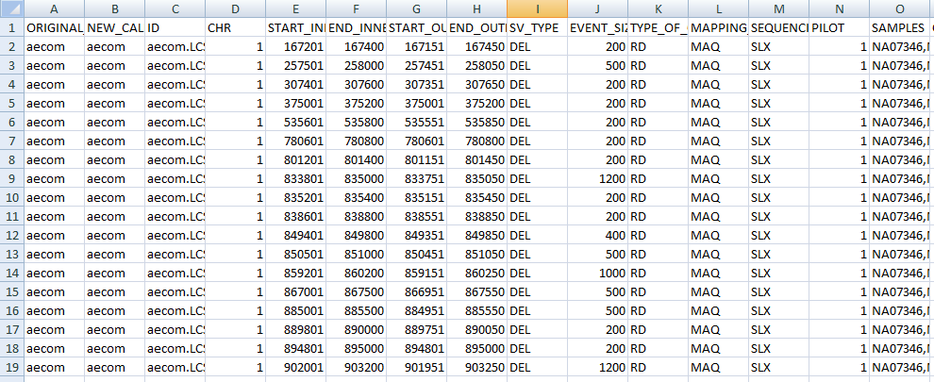

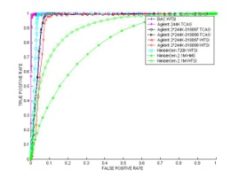
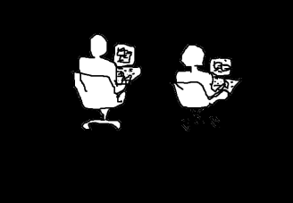
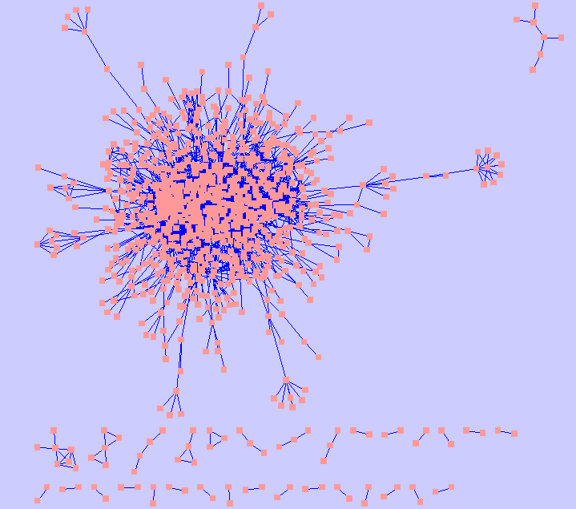

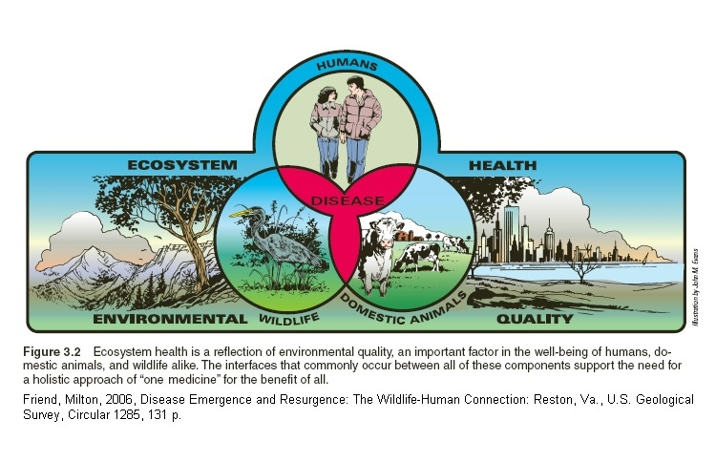

Bioinformatics
DATA
BLACKBOX
RESULTS
Human Genetics

Slide 4
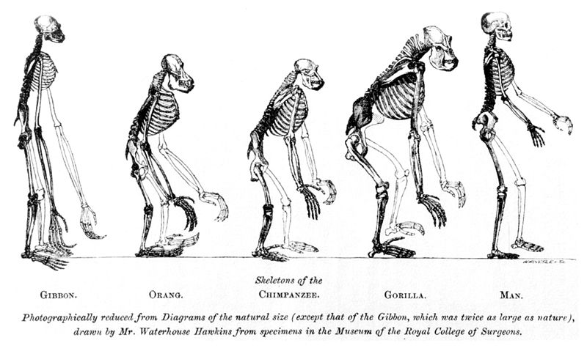
Human’s Place in Nature

Slide 5
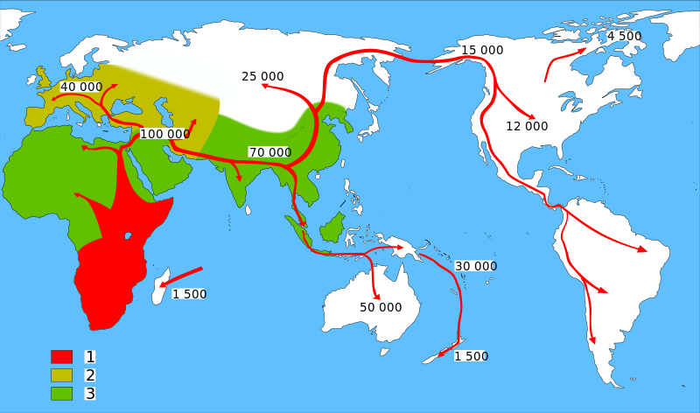
Map of early human Migrations “Out-of-Africa”
Homo sapiens (model humans)
Neanderthals (extinct human)
Early Hominids (early humans)
http://en.wikipedia.org/wiki/Recent_African_origin_of_modern_humans

Slide 6
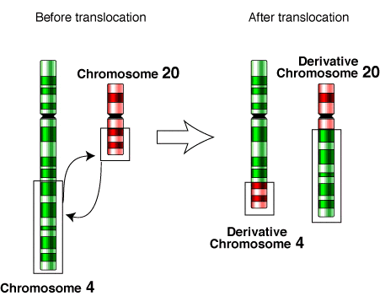
Genetic Variants
Ref.
A
Sample
C
Single Nucleotide Polymorphisms (SNPs, over a hundred million, ~0.1% genetic difference)
1bp
Small Insertions and Deletions (INDELs, tens of millions, ~0.2-0.3%)
Multiple base pairs (1bp ~ 50bp, arbitrary)
Structural Variants (SVs, ~100 thousand, ~0.6-0.7% genetic difference)
A large number of base pairs (50bp+, arbitrary)
Encompasses:
Copy number variants (CNVs: Deletions, Duplications, Insertions)
Balanced events (Inversions, Translocations)
Ref.
A
Sample
TCA
Deletion
Duplication
Insertion
Inversion
Ref.
Ref.
Ref.
Ref.
Sample
Sample
Sample
Sample
Notes:
Now let’s look at different types of genetic variants in our genomes.
The most well studied category of genetic variants include SNPs. It is estimated that there would be over a hundred million SNPs in human genome. These SNPs make up around 0.1% genetic difference between any two of us.
The second category of genetic variants is composed of indels.
Another category of include large SVs. From 50bp to mega base pairs. they can also reach to the whole chromosome.
SVs encompass several forms, from copy number variants including, to balnaced events.
Switch of direction of DNA segement and translocations that involve in the exchange of DNA content between two different chromosomes.
It is estimated that there are over a hundred thousand of SVs. Although we have fewer SVs in our genomes comparing to SNPs. Due to their large sizes, they contribute to 6 to 7 fold of genetic diff than SNPs.
I’ll touch on SNPs and INDELs, however, in this talk I’ll focus on SVs that our lab has been pioneered in.
Focus on SVs, particularly CNVs (large deletions)
Mosaism
Why do we care about these SVs?

Slide 7
SVs and Human Disease
SVs are know to contribute to numerous diseases.
CNVs play a role in cancer, autism spectrum disorder, schizophrenia, and several developmental disorders (Cook’s syndrome).
Pancancer analyses on TCGA data have found several occurrences of enhancer hijacking due to SVs.
Left: t(9;22)(q34.1,q11.2) Philadelphia chromosome discovered in 1959.
Common, translocation in Acute myelogenous Leukemia and acute lymphoblastic leukemia.
https://www.cancer.gov/publications/dictionaries/cancer-terms/def/philadelphia-chromosome
Notes:
The name is actually a reference to a well-characterized genomic rearrangement called Philadelphia chromosome.
Several forms of cancer result from acquired translocation events, and in this case, two nonhomologous regions are fused together leading to the expression of an oncogenic protein product, BCR-ABL1. Normally ABL1 functions as a tyrosine kinase and when fused to BCR the protein product is is an unregulated cytoplasmic kinase. The resulting effect is cellular proliferation without the normal cytokine regulation of kinase activity.
The cases of Ph-like leukemia have a similar expression profile to the BCR-ABL1 variety, yet lack the characteristic fusion protein.

Slide 8
SVs and Human Disease
Gene | Cancer syndrome | References on genomic deletions or duplications
APC | Adenomatous polyposis coli; Turcot syndrome | Hodgson et al. and Su et al. and Aretz et al. and Charames et al.
BMPR1A | Juvenile polyposis | Delnatte et al.
BRCA1 | Hereditary breast/ovarian cancer | Petrij-Bosch et al. and Montagna et al.
BRCA2 | Hereditary breast/ovarian cancer | Casilli et al.
CDKN2A-p14ARF | Familial malignant melanoma | Lesueur et al.
CDKN2A-p16(INK4a) | Familial malignant melanoma | Lesueur et al.
CHEK2 | Familial breast cancer | Cybulski et al.
FANCA | Fanconi anemia A | Levran et al.
MADH4 | Juvenile polyposis | van Hattem et al.
MEN1 | Multiple endocrine neoplasia type 1 | Kishi et al.
MLH1 | Hereditary non-polyposis colorectal cancer, Turcot syndrome | Nystrom-Lahti et al. and Chan et al.
Germline cancer genes in the Cancer Genes Census reported to be mutated by genomic deletion or duplication
Gene | Cancer syndrome | References on genomic deletions or duplications
MSH2 | Hereditary non-polyposis colorectal cancer | Stella et al.
MSH6 | Hereditary non-polyposis colorectal cancer | Plaschke et al.
NF1 | Neurofibromatosis type 1 | Riva et al. andBausch et al.
NF2 | Neurofibromatosis type 2 | Tsilchorozidou et al.
PRKAR1A | Carney complex | Horvath et al.
PTCH | Nevoid basal cell carcinoma syndrome | Shimkets et al.
RB1 | Familial retinoblastoma | Bremner et al.
SDHB | Familial paraganglioma | Cascon et al.
(Shlien, 2009)
Notes:
A collection of recognized CNVs

Slide 9

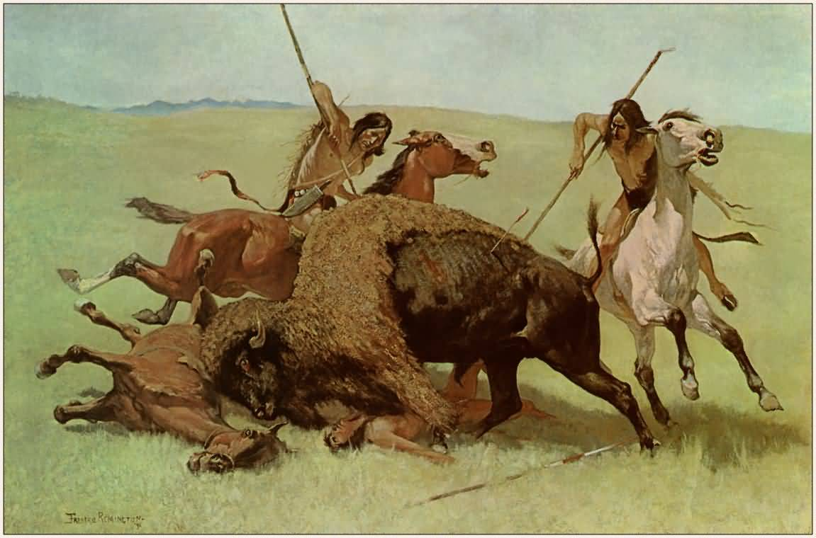
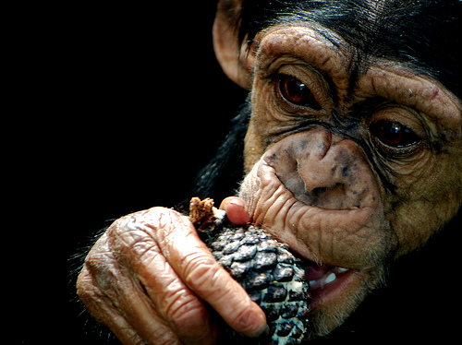
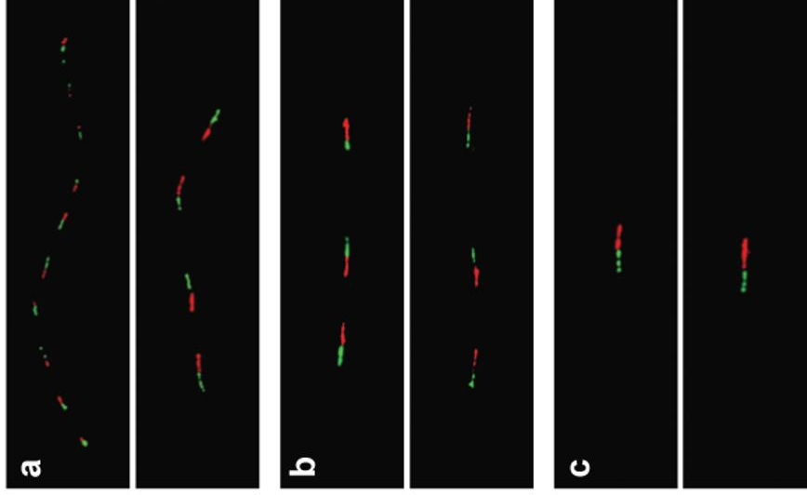


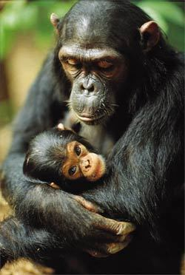
Salivary amylase gene
Salivary amylase gene Amy1: More copy numbers in populations with high-starch diets.
Japanese
Biaka (Africa)
Chimpanzee
Perry GH et al. Nature Genetics 2007
Notes:
Two studies in 2004, including one from my lab, laid the foundations of studying SVs in human population.
A follow up study in my lab in 2007, presented the first example of positive selection on a copy number-variable gene Amy1. Individuals with high-starch diets tend to have a higher copy number of the salivary amylase gene Amy1 (which helps with starch digestion), compared to those populations with low-starch diets.
fiber FISH validation of AMY1 copy number estimates.
Red (10 kb) and green (8 kb) probes encompass the entire AMY1 gene and a retrotransposon directly upstream of (and unique to) AMY1, respectively. (a) Japanese individual GM18972 was estimated by qPCR to have 14 (13.73 0.93) diploid AMY1 gene copies, consistent with fiber FISH results showing one allele with ten copies and the other with four copies. (b) Biaka individual GM10472 was estimated by qPCR to have six (6.11 0.17) diploid AMY1 gene copies, consistent with fiber FISH results. (c) The reference chimpanzee (Clint; S006006) was confirmed to have two diploid AMY1 gene copies.
hunter-gatherer lifestyle

Slide 10
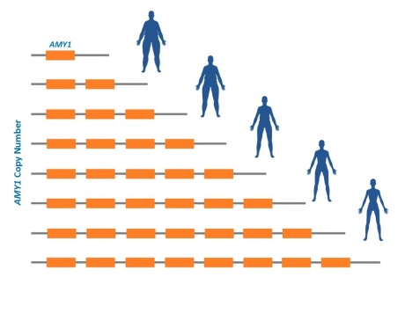
AMY1 and Obesity
Individuals with more copies of AMY1 were at lower risk of obesity.
The chance of being obese for people with <4 copies of the AMY1 gene was approximately 8 times higher than in those with more than 9 copies of this gene.
The researchers estimated that with every additional copy of the salivary amylase gene there was approximately a 20% decrease in the odds of becoming obese.
Falchi M et al. Nature Genetics 2014
Notes:
Researchers from Imperial College London, in collaboration with other international institutions, looked at the number of copies of the gene AMY1 present in the DNA of thousands of people from the UK, France, Sweden and Singapore. They found that people who carried a low number of copies of the salivary amylase gene were at greater risk of obesity.

Slide 11
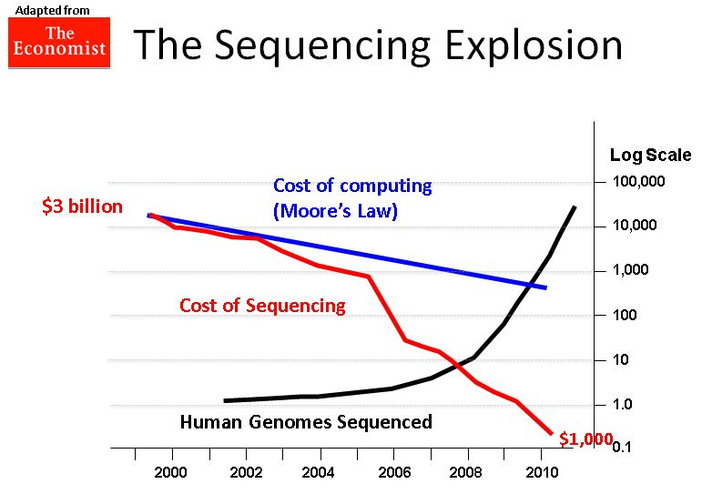
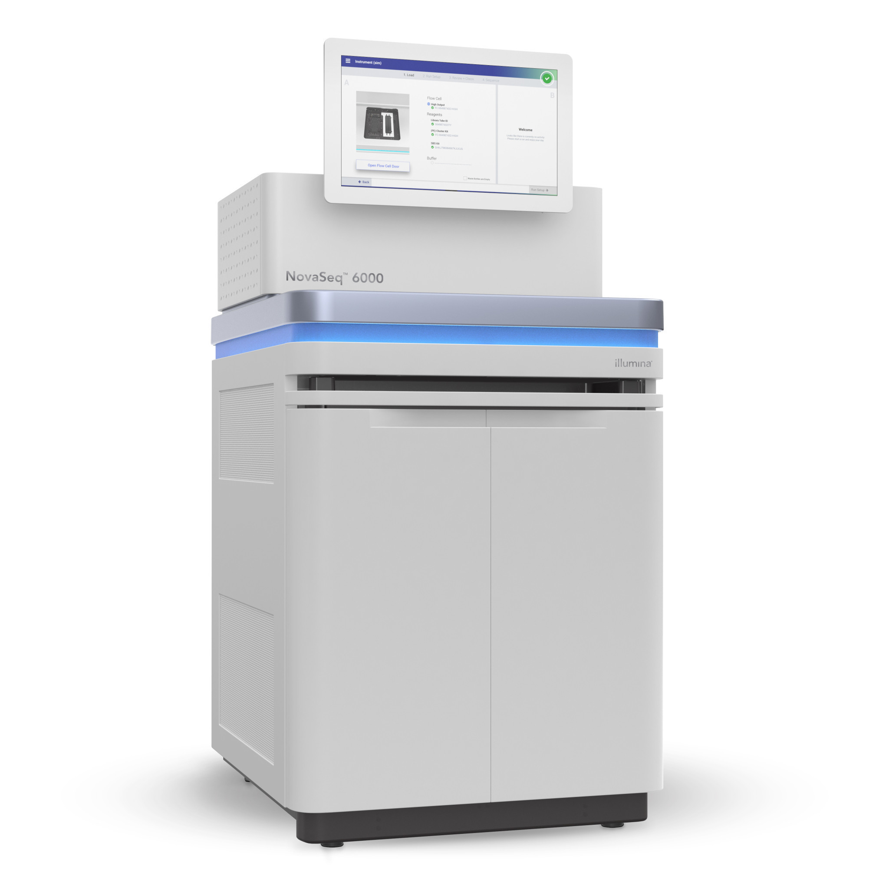
Now the bottleneck is computing/informatics
Processing this 3-billion-base-pair human genome takes immense computing power
1988
NIH &DOE
Human Genome Project
2017
Sanger sequencing:
$3 billion per human genome
~5 years
Illumina NovaSeq:
$100 per human genome
1 hour
Notes:
This departure from Moore’s law indicates that the transition between these technologies introduced a new cost-scaling regime.
https://www.genome.gov/12011239/
turning point 2005
Illuminar XTen $1000
$100
Bottleneck: informatics and analytics

Slide 12
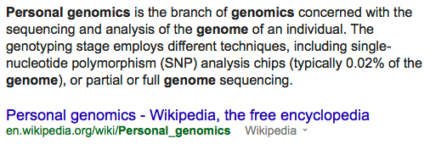
Personal Genomics

Slide 13
Big Data Era for Genetics
The 1000 Genomes project has sequenced 2,504 individuals in total.
As of March 2013 our ftp site is 464 terabytes and continuing to grow.
Can store ~145,000,000 MP3 songs.

Slide 14
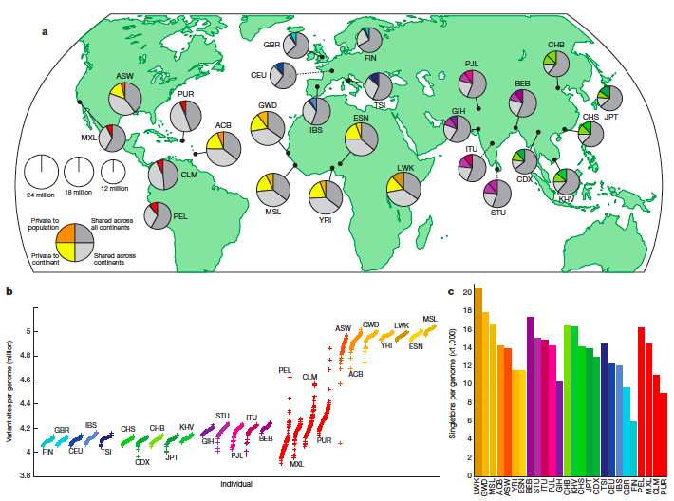
The 1000 Genomes Project
SNP-SNV expression quantitative loci mapping analysis:
We identified 54 eQTLs with a lead SV association (denoted SV-eQTL) and 10,100 eQTLs with a lead SNP association (10% FDR).
Although SNPs contribute more eQTLs overall, our results suggest SVs have a disproportionate impact on gene expression relative to their number.
Whole genome sequencing of 2504 individuals from 26 populations.
A typical genome differs from the reference human genome at 4.1 ~5.0 million sites (2,100 ~2,500 structural variants). 1000 Genomes Project Consortium. Nature 2010, 2011, 2012, 2015, 2016b.
Notes:
A – Total number of samples sequenced; B – Source of DNA (blood (bld) or LCL); C – Gender composition (Male/Female); D – Number that are part of mother-father-child trios (t), parent-child duos (d) or singletons (s).
What’s ACB, PEL, ITU, GIH, STU?

Slide 15
Clinical Sequencing – Federal Initiatives
Million Genome Project from Obama’s Precision Medicine Initiative, 2015.
Genomes England Project (the 100,000 Genomes Project) 2014, UK 10K Project.
Million Veterans Project US, already collected DNA samples from 343,000 former soldiers 2015.
International Cancer Genome Consortium (ICCG) and The Cancer Genome Atlas (TCGA) projects chart the genomic changes involved in more than 20 types of cancer (WGS of 5000 individuals, WES of 10,000 individuals).

Slide 16
Clinical Sequencing – Private Sections
J. Craig Venter plans to sequence one million genomes by 2020 using private funding.
One of the world’s largest private bio-banks, 23andMe, collected 800,000 spit samples.
Large disease consortia and hospitals/institutions/pharmaceutical/biotech companies conduct whole genome sequencing of clinical samples.
Notes:
Google Genomics
Facebook?

Slide 17
From Genomics to Metagenomics
Microbes thrive on us: we provide wonderfully rich and varied homes for our 100 trillion microbial (bacterial and archaeal) partners.
Human Microbiome Project
characterize microbial communities found at multiple human body sites and to look for correlations between changes in the microbiome and human health.
We are also host to countless viruses. A recent survey reported that human feces contain about a billion RNA viruses per gram, representing 42 viral “species”.
Viral Metagenomics
National Research Council (US) Committee on Metagenomics: Challenges and Functional Applications. 2007

Slide 18
Outline
A Brief Introduction to Bioinformatics and Human Genetics
Joint Effect of Genetic Variants on Phenotypes
A Network Approach for Integrative Analysis of Genomic Data
Genetic Privacy
Summary and future work

Slide 19
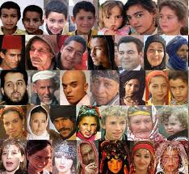
Genome Wide Association Study
The 1000 Genomes Project
Genome Wide Association Study (GWAS)
Genetic Variation
Phenotypic Variation
Sample_1
Sample_2
Sample_3
……
Sample_n-1
Sample_n
Notes:
Excited!!!
Building catalog, in the hayday of looking at these
Resource. Post-1000GP era
Now we have a list of genetic variants, let’s look at how they contribute to phenotypic variation through GWAS

Slide 20
Strategies for Genetic Analysis
Families -- Linkage Studies
Populations -- Association Studies
C
/
C
C
/
T
C
/
C
C
/
T
C
/
C
C
/
T
C
/
C
C
/
C
4
0
%
T
,
6
0
%
C
1
5
%
T
,
8
5
%
C
C
/
T
C
/
C
C
/
T
C
/
T
C
/
C
C
/
C
C
a
s
e
s
C
o
n
t
r
o
l
s
Continuous
Simple Inheritance
Complex Inheritance
Multiple Genes
Single Gene
Common Variants
Frequency
300,000 -1,000,000 SNPs
Rare Variants
~600 Short Tandem Repeat Markers
Phenotype Measure

Slide 21
Approaches to Association Studies
Directed - Candidate Gene Studies
Resequencing SNP data
Whole Genome Association Studies (WGAS) - tagSNPs
Continuous
Quantitative
Frequency
4
0
%
T
,
6
0
%
C
1
5
%
T
,
8
5
%
C
C
a
s
e
s
C
o
n
t
r
o
l
s
Phenotype Measure

Slide 22
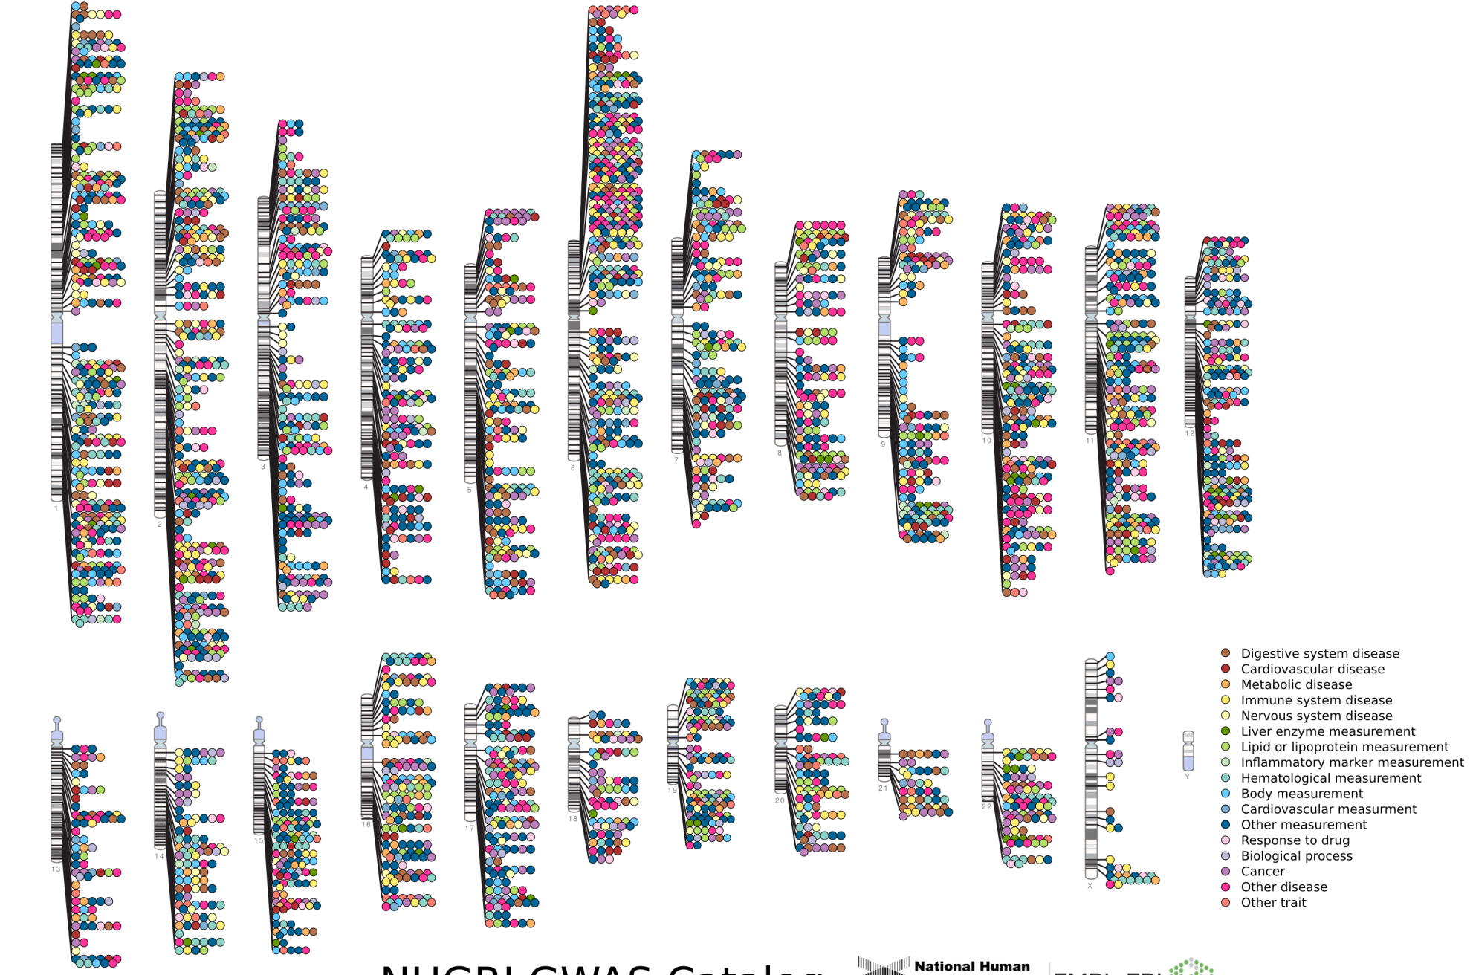

Published Genome-Wide Associations through 12/2013
Published GWA at p≤5X10⁻⁸ for 17 trait categories
NHGRI GWA Catalog
www.genome.gov/GWAStudies
www.ebi.ac.uk/fgpt/gwas/
Notes:
chromosome ideogram

Slide 23
NHGRI GWA Catalog
www.genome.gov/GWAStudies
www.ebi.ac.uk/fgpt/gwas/

Slide 24
Missing/Hidden Heritability
GWAS hits only explain a small portion of the heritability
height ~80%; 12 SNPs together ~2% (Lettre et al., Nat Genet., 2008), 180 SNPs ~10% (GIANT, Nature, 2010); 294,831 SNPs ~45% (Yang et al., Nature, 2011)
(Missing) Hidden Heritability:
Rare variants
A comprehensive list of genetic variants (SNPs, INDELs,SVs)
Joint effect of multiple variants (Epistasis/gene-gene interactions, pathways/subnetworks)
Two-hit disease model for developmental delay: (16p12.1 deletion, 14q11.2 deletion) (Girirajan et al., Nat Genet. 2010)
Gene-environment interactions and epigenetics
Notes:
Figure for height
Despite the success of GWAS of identifying SNPs associated with diesease, the major criticism/concern of GWAS is that these GWAS hits only
There is a growing evidence that even all the common variants are combined, we cannot explain all of the heritability of traits. This leads to an argument that the heritability is not missing, but hidden in other factors.
, was reported to pair with a second-hit CNV involving a 1.5Mb deletion ay chromosome locus
I am particularly interested in the joint effect of multiple variants on phenotypes. Now let’s look at how we address this problem.

Slide 25
Joint Effect of Genetic Variants
Notes:
An illustration of the scenario that multiple genetic variants (e.g. genic CNVs) overlapping with genes, in the form of a subnetwork, are jointly associated with different phenotypes. Genetic variants are treated as features and categorical phenotypes are represented as labels in the models. Each of three exemplar genic CNVs (CNV A, CNV B, CNV C) has three genotypes (CN0, CN1, CN2) and overlaps with corresponding genes (Gene A, Gene B, Gene C). The subnetwork/pathway among these genic CNVs, as shown in the dotted oval, is formed by connecting the corresponding genes with biological interactions such as protein-protein interactions extracted from a protein-protein interaction network. The feature matrix is formed by coalescing the genotype profiles of all the samples under investigation. The open squares on labels represent the phenotype class of 0 and the closed squares represent that of 1. In this example, sample 2 is associated with phenotype class 1 has the only genotype combination (CN0, CN0, CN1) for the three CNVs respectively, as marked in closed squares for the genotype profiles and highlighted in blue square in the feature matrix. The samples with all the other combinations of genotypes for the three CNVs (open squares of the genotype profiles in the features) are associated with phenotype class 0.

Slide 26
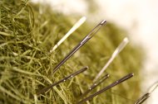
Challenges
Computational challenge
“needles in a haystack”
The inhibitive number of combinations of a large number of genetic variants: O(2^{p})
Infeasible to do an exhaustive search
Biological challenge
What combinations of variants we should prioritize?
Notes:
The changes for identifying such joint effect of multiple variants lie in two-folds.
N is a large number, tens of thousands CNVs, tens of millions of INDELs/SNPs
Imagine these needles are tied together along a string, then it’s easier to find them in a haystack

Slide 27
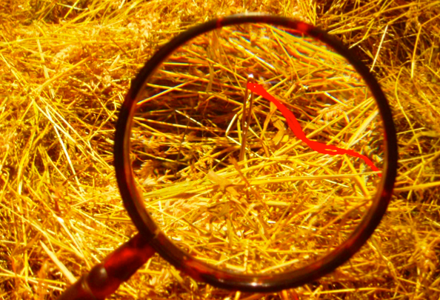
Methodology - CNVnet
Statistical/machine learning (group LASSO logistic regression model)
Sparse learning on high-dimensional data
The number of features/CNVs is significantly larger than the number of samples in the data set (n << p)
Only a small fraction of CNV combinations are associated with phenotypes
Biological networks (interactive CNVs on a functional variant network)
Needles tied along a thread (“needles in a haystack”)
Notes:
Back to the needles in the haystack analogy. Imagine these needles are distributed but there a few that are tied together along a thread. We will focus on these linked needles because they are easier to spot than dispersed ones.

Slide 28
Results: CEU vs. non-CEU
The expression of PTEN explained some population stratification between CEU and ASN (Spielman RS et al., Nat Gen, 2009).
PTEN mutation is more frequent in Caucasians relative to African Americans and is associated with favorable survival in advanced endometrial cancer (Maxwell GL et al., Clinical Cancer Research, 2000).
Notes:
The mutations of PTEN tumor suppressor gene have been reported to have population disparity in cancers:
These observations may imply that besides PTEN, the other genes in this group should be checked for their population disparity and additionally examined for their effects on outcome in these cancer types.

Slide 29
Outline
A Brief Introduction to Bioinformatics and Human Genetics
Joint Effect of Genetic Variants on Phenotypes
A Network Approach for Integrative Analysis of Genomic Data
Genetic Privacy
Summary and future work

Slide 30

MicroRNAs and Ovarian Cancer
MicroRNAs (miRNAs) are small (22 nucleotides) non-coding regulatory RNAs.
miRNAs regulate gene expression by targeting complementary mRNA for translational blockade or degradation.
Differential miRNA expression and miRNA dysregulation have been associated with cancer signatures, including ovarian cancer.
A study by The Cancer Genome Atlas (TCGA) examined mRNA transcription and miRNA expression in high grade serous ovarian cancer, and found three miRNA subtypes.

Slide 31
Questions and Approach
How does miRNA affect gene expression in ovarian cancer both locally and distally?
What’s the underlying network for such effect?
Borrowed the idea from gene expression quantitative trait loci (eQTL) mapping.
Genome-wide mapping of miRNA-gene expression quantitative trait loci (ieQTL) using the ovarian cancer data from The Cancer Genome Atlas (TCGA).
Notes:
Combinatorial regulation is a feature of miRNA regulation. A given miRNA may have multiple different mRNA targets, and a given target might similarly be targeted by multiple miRNAs.

Slide 32
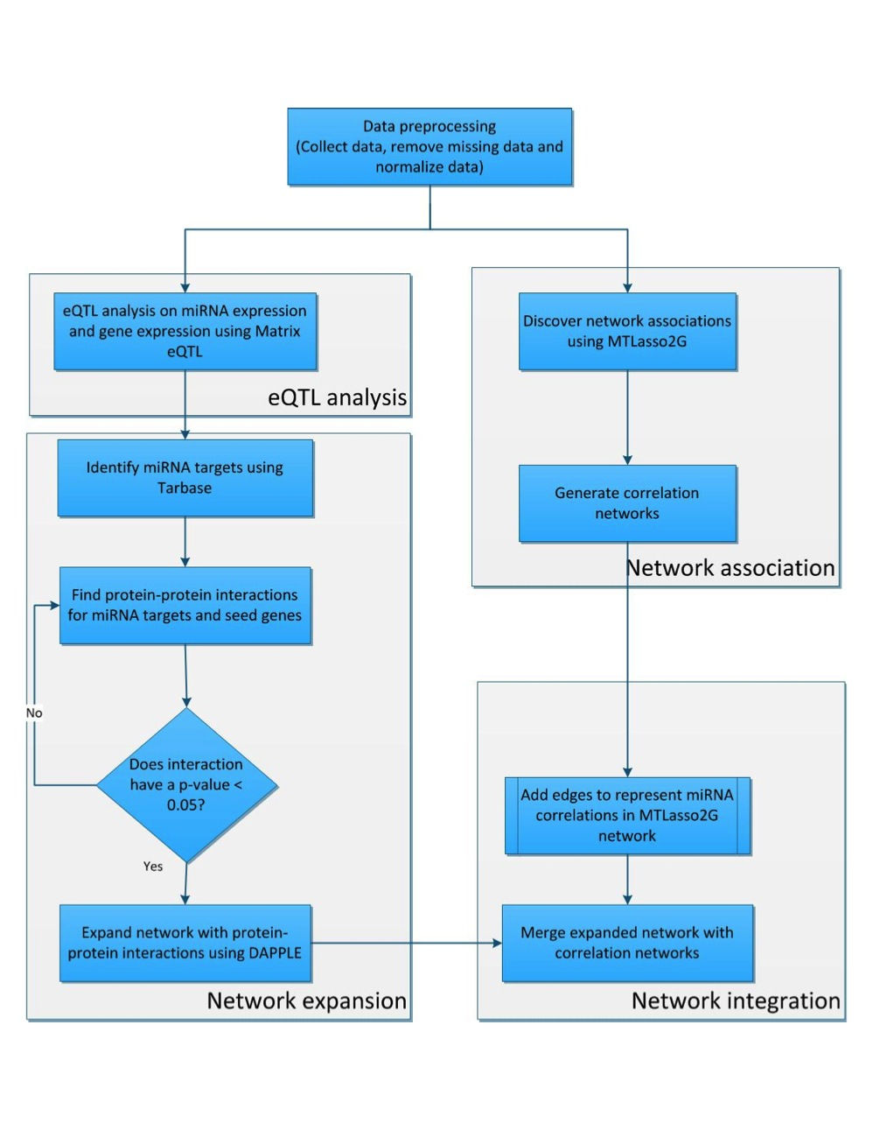

Slide 33
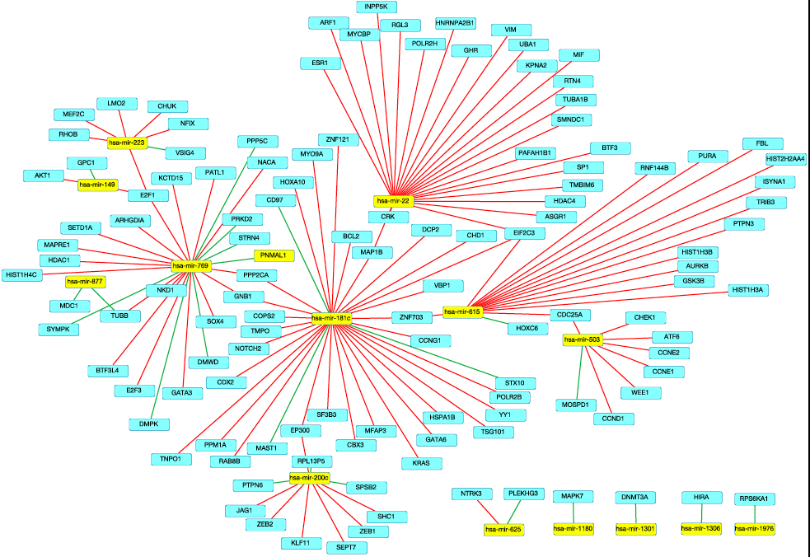

Slide 34
Multi-Omics Data Integration
Genome Wide Association Study (GWAS)
Genetic Variation
Phenotypic Variation
Sample_1
Sample_2
Gene Expression Variation
Sample_3
Methylation Variation
……
Sample_n-1
Dnase I Sensitivity Variation
Sample_n
MicroRNA Variation
mQTL
dsQTL
eQTL Mapping
miRNA eQTL

Slide 35
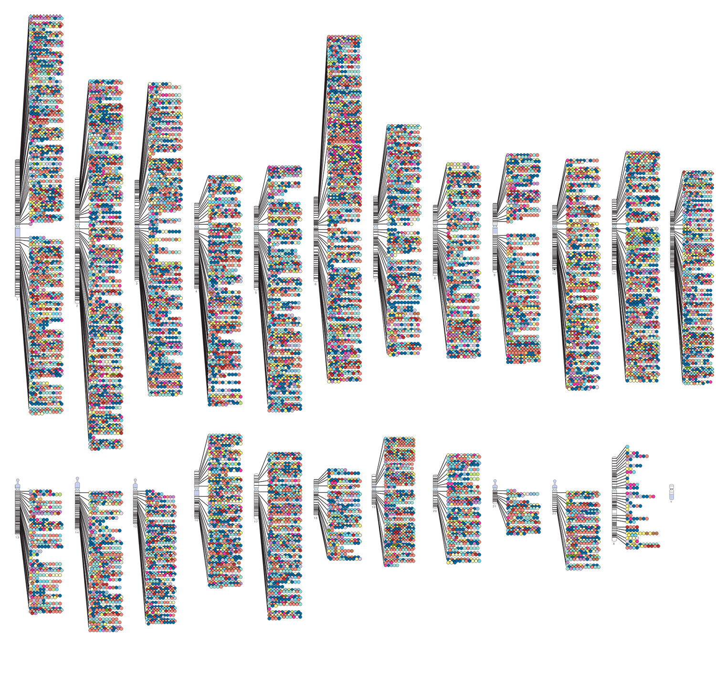
Published Genome-Wide Associations through 04/2018
Published GWAS at p≤5X10⁻⁸
GWAS Catalog
www.ebi.ac.uk/fgpt/gwas/
Notes:
chromosome ideogram
Conduct disease association using GWAS, however, still exists some problems, such as the hidden heritabilities.
SNP only, MAF > 0.05, single locus test, high dimensionality, limited sample size induces hardware limitations and and time consuming.

Slide 36
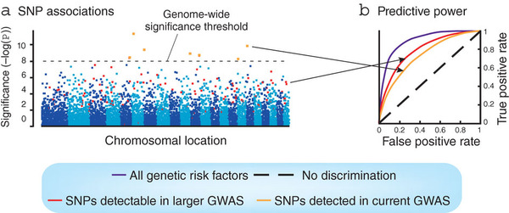
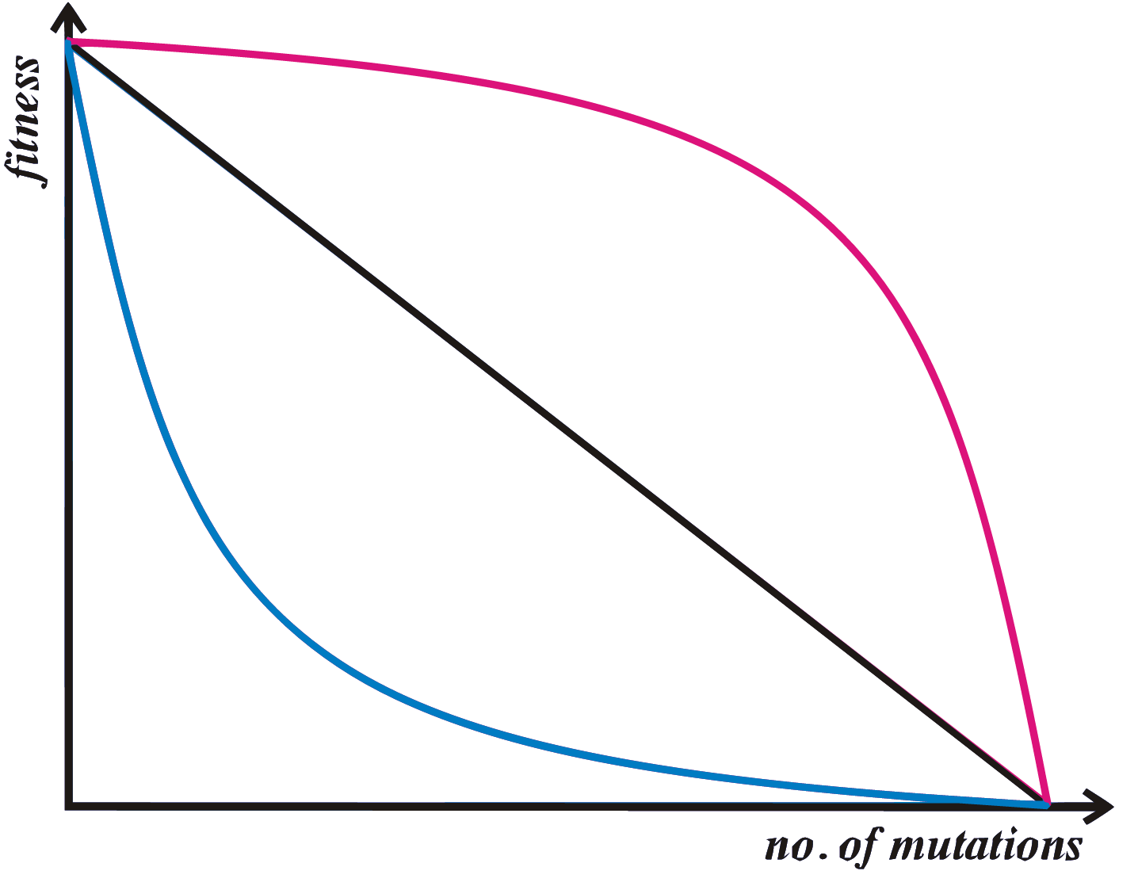
Missing/Hidden Heritability
GWAS hits only explain a small portion of the heritability
height ~80%; 12 SNPs together ~2% (Lettre et al., Nat Genet., 2008), 180 SNPs ~10% (GIANT, Nature, 2010); 294,831 SNPs ~45% (Yang et al., Nature, 2011)
(Missing) Hidden Heritability:
Rare variants
A comprehensive list of genetic variants (SNPs, INDELs, SVs)
Joint effect of multiple variants (Epistasis/gene-gene interactions, pathways/subnetworks)
Two-hit disease model for developmental delay: (16p12.1 deletion, 14q11.2 deletion) (Girirajan et al., Nat Genet. 2010)
Epigenetics (microRNAs, DNA methylation, histone modification, etc.)
Gene-environment interactions
Synergistic epistasis
Antagonistic epistasis
Gibson, Nature Genetics, 2010
Notes:
polygenic models (additive models)
Despite the success of GWAS of identifying SNPs associated with diesease, the major criticism/concern of GWAS is that these GWAS hits only
There is a growing evidence that even all the common variants are combined, we cannot explain all of the heritability of traits. This leads to an argument that the heritability is not missing, but hidden in other factors.
, was reported to pair with a second-hit CNV involving a 1.5Mb deletion ay chromosome locus

Slide 37
Sparse Learning and Predictive Modeling of Genomic Data
B
(Associations)
X
(Genotypes)
Y
(Phenotype)
b₁
b₂
v₁
b₃
v₂
v₃
…
v_{p}
s₁
y₁
s₂
y₂
s₃
y₃
+ E ≈
…
…
…
(Noise)
s_{n}
y_{n}
X is high dimensional:
n << p
b_{m}
$$y= μ+Xβ+ ε$$

Slide 38
Sparse Learning and Shrinkage
The statistical techniques in Empirical Bayesian Elastic net (EBEN) are shrink operator and variable selection
Suitable for high dimensional data.
Two-level prior distribution for unknown parameters
Coordinate ascent method for optimization
Non-zero coefficients by estimating covariances and performing t-tests

Slide 39
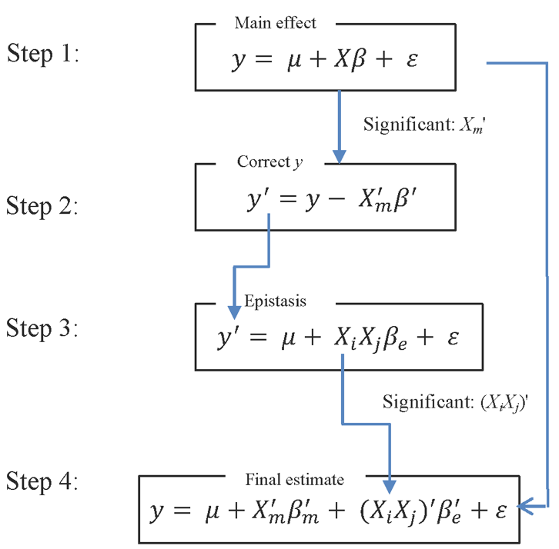
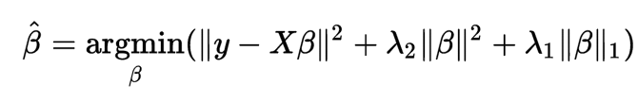
EpiEBEN: An Epistasis Workflow
https://github.com/shilab/EBEN-epistasis
Wen J. et al. ISBRA 2015. BMC Genomics 2017.
Empirical Bayesian Elastic Net (EBEN) algorithm, Huang, et al., Heredity, 2015.
Notes:
Develop covariate-aware models for pairwise epistatic analysis on a categorical trait; (2) Develop scalable methods for multilocus and
multi-trait epistatic analysis.
EBEN: Use the non-zero coecients and covariance matrix to conduct t -test to
perform hypothesis test on the estimated value.
For example, in the "large p, small n" case (high-dimensional data with few examples), the LASSO selects at most n variables before it saturates. Also if there is a group of highly correlated variables, then the LASSO tends to select one variable from a group and ignore the others. To overcome these limitations, the elastic net adds a quadratic part to the penalty ( L2), which when used alone is ridge regression (known also as Tikhonov regularization).
The quadratic penalty term makes the loss function strictly convex, and it therefore has a unique minimum. The elastic net method includes the LASSO and ridge regression.

Slide 40
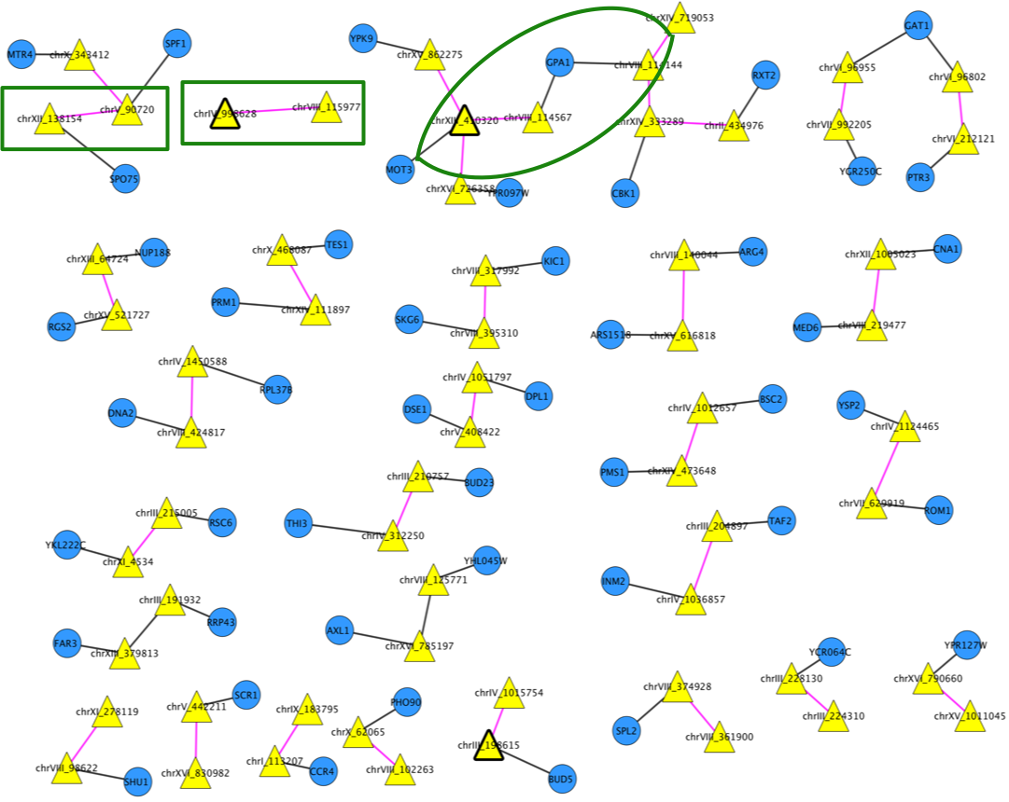
Yeast Epistasis Analysis
Two SNPs (chrVIII:114144 and chrVIII:114567) identified to have both marginal and epistatic effects, map to gene GPA1.
GPA1 affects the yeast response to mating pheromone, which corresponds to the yeast pheromone response pathway and further affects fitness as measured by indole acetic acid production [1, 2].
[1] Bloom, J. S., et al. (2015). Genetic interactions contribute less than additive effects to quantitative trait variation in yeast. Nature communications, 6, 8712
[2] Forsberg, S. K., et al. (2016). Accounting for genetic interactions improves modeling of individual quantitative trait phenotypes in yeast. Nature genetics. 2017 Apr;49(4):497.

Slide 41


Multi-locus multi-trait Epistasis Analysis
https://github.com/shilab/EBEN-epistasis
Methodology
We developed EpiEBEN for pairwise epistasis analysis at genome scale.
Extend EpiEBEN to allow covariate-aware models for pairwise epistatic analysis on any type of trait (binary, categorical, quantitative).
Develop methods for multi-locus and multi-trait epistatic analysis.
Applications
The Cancer Moonshot Pilot Project (Precision Medicine Initiative)
Plant Microbiome Interface
Funded by NIH
https://github.com/shilab/parEBEN
Fangfang Xia
Rick Stevens
Bob Cottingham
David Weston
Wellington Muchero
Notes:
A variety of classical clustering
methods will be provided as options to cluster traits

Slide 42
Overview
The 1000 Genomes Project
Genome Wide Association Study (GWAS)
Quantitative Trait Locus (QTL) Mapping
Phenotypic Variation
(Diseases)
Genetic Variation
Gene Expression Variation
Sample_1
Sample_2
Sample_3
……
eQTL
Sample_n-1
Sample_n
Gene expression variation is important for evolution and diseases
Growing evidence that gene expression variation is a key contribution to functional variation and phenotypic variation
Need to understand the genetic mechanisms underlying natural variation in gene expression

Slide 43
eQTL Mapping
Expression quantitative trait locus (eQTL) mapping
Identify genetic variants that significantly affect the variation of expression levels of genes
One-to-one mapping (pairwise association)
One genetic variant affects the expression of a single gene, assuming independence of genetic variants and gene expressions
Genetic Variation
Gene Expression Variation
Sample_1
Sample_2
Sample_3
……
Sample_n-1
Sample_n
Brown et al. PNAS 2012, Tian et al. TSJ, 2014
Notes:
Treat gene expression as a quantitative trait

Slide 44
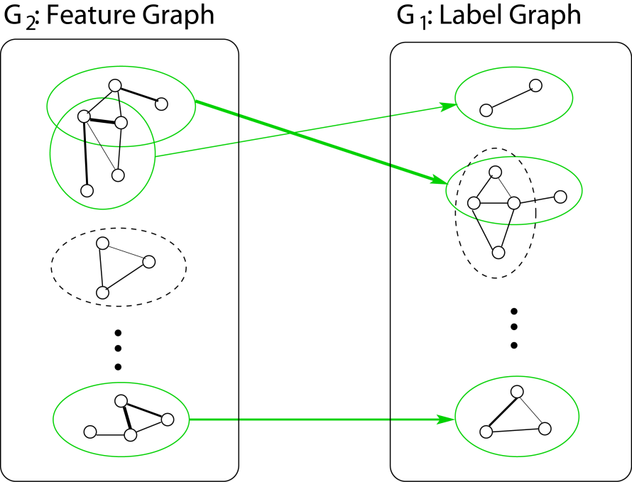
Problem
Subnetwork-to-Subnetwork Association (many-to-many mapping)
Multiple variants (in a subnetwork/pathway) affect the expression of multiple genes (in a subnetwork/pathway)
Genetic Variants
Genes
Genetic Variants (X:Feature)
Gene Expression(Y:Label)
Sample_1
Sample_2
Sample_3
……
Sample_n-1
Sample_n
Subnetwork-to-Subnetwork Association
Xinghua Mindy Shi, xshi1@rics.bwh.harvard.edu 44 HMSGTP Research Seminar, 03/16/2012

Slide 45
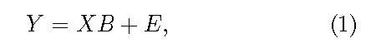
Sparse Learning for eQTL Mapping
n<<p
B
(Associations)
X
(Genotypes)
Y
(Phenotypes)
b₁
b₂
b₃
g₁
g₂
…
v₁
g_{k}
v₂
v₃
…
v_{p}
s₁
y₁
s₂
y₂
s₃
y₃
+ E ≈
…
…
…
(Noise)
s_{n}
y_{n}
b_{m}

Slide 46
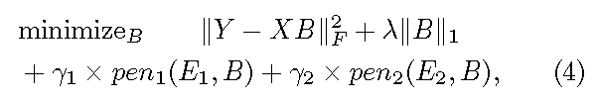
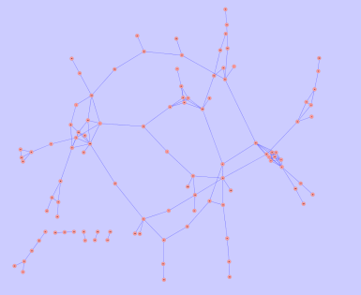
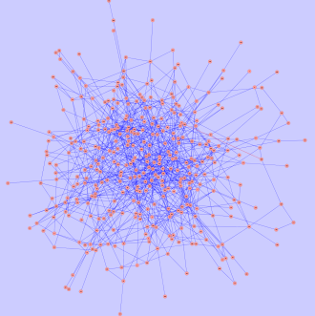
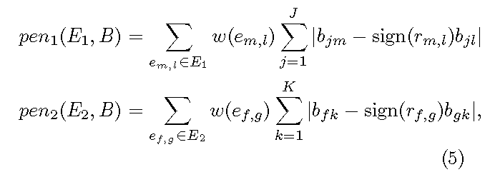
Two-Graph Guided Multi-task Lasso
Subnetwork-to-subnetwork association (MtLasso2G)
Many-to-many mapping
G2: Feature Graph
G1: Label Graph
B = (b₁₁, …, b_{JK})
X = (x₁₁, …, x_{nJ})
Y= (y₁₁, …, y_{nK})
…
 | chr4:76580182- 76580261 | chr7:38479532-38479868 | chr10:100015109-100015443
NA18486 | 0 | 0 | 1
NA18498 | 0 | 1 | 2
NA18521 | 2 | 2 | 2
 | ACCN3 | G3BP2 | AVPI1
NA18486 | 2.1325636 | 1.0378776 | -1.8572543
NA18498 | 1.9537768 | -0.7802166 | -2.4448123
NA18521 | -2.0653763 | 0.9428551 | 1.3716614
……
+ E’ ≈
…
Notes:
coordinate descent algorithm
The objective function with L1 penalty is non-dierentiable and its optimization is achieved
by transforming it to a series of smooth functions that can be eciently
minimized by the coordinate-descent algorithm. Specically, our algorithm
works as follows. First, we consider the following constrained ridge-type optimization

Slide 47
Machine Learning Workflow for Modeling High-dimensional Multi-omics Data
INPUT (n<<p)
Genetic Variants (X: Feature)
Gene Expression(Y:Label)
Sample_1
Sample_2
Network/pathway Databases
Sample_3
……
Sample_n-1
Sample_n
…
G2: Feature Graph
G1: Label Graph
OUTPUT
MODEL
Two-Graph Guided Multi-task Lasso Model (MtLasso2G)
Chen X, Shi X, et. al. AISTATS 2012.
Quitadamo A. et al. ISBRA 2014, BMC Bioinformatics 2015
Hall B. et al. BIGCOM 15, TSI 16. Johnson et al. ACM BCB 2017.
https://github.com/shilab/MTLasso2G
Notes:
Deep learning, information theory
LASSO (least absolute shrinkage and selection operator)

Slide 48
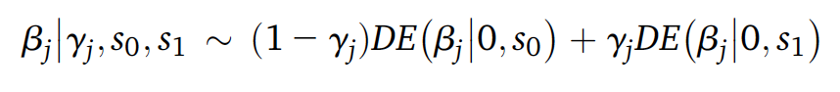
Extension to Spike-and-Slab Lasso Models
INPUT (n<<p)
Genetic Variants (X: Feature)
Gene Expression(Y:Label)
Sample_1
Sample_2
Network/pathway Databases
Sample_3
……
Sample_n-1
Sample_n
…
G2: Feature Graph
G1: Label Graph
OUTPUT
MODEL
Two-Graph Guided Multi-task Lasso Model (MtLasso2G)
Group Spike-and-slab Lasso Model (gssLasso)
Chen X, Shi X, et. al. AISTATS 2012.
https://github.com/shilab/MTLasso2G
Tang Z, et al. Bioinformatics 2017.
http://www.ssg.uab.edu/bhglm/
Notes:
Summary
Problem with Lasso: shrink relevant features. Ideally: don’t shrink relevant/large-effect features but shrink irrelevant features to 0
hierarchical spike-and-slab GLMs
hierarchical modeling (or penalization in non-Bayesian), i.e., specifying priors (or penalty) on the coefficients.
extending the double-exponential prior to the spike-and-slab mixture double-exponential (DE) prior (beta-j follows DE or normal distribution)

